Slide 1
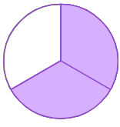
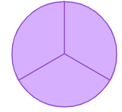

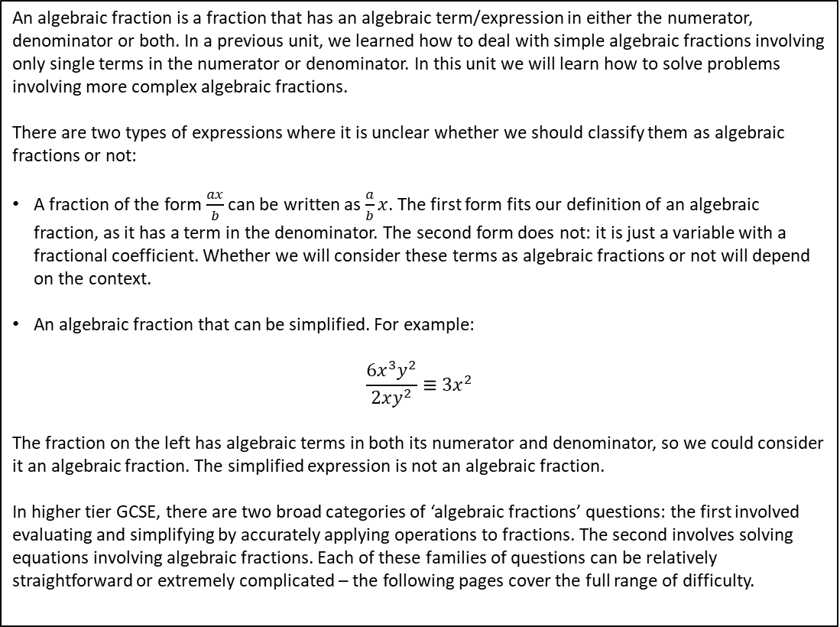
Subtopic 4a – Algebraic Fractions: Manipulation and Simplifying
LEARNING OUTCOME: To simplify and solve algebraic fractions.
Objectives:
Keywords:
Fraction
Solve
Factorise
Denominator
To be able to simplify basic algebraic fractions.
To be able to simplify algebraic fractions by factorising.
To multiply and divide with algebraic fractions.
To solve equations involving algebraic fractions.
An algebraic fraction is a fraction that has an algebraic term/expression in either the numerator, denominator or both. In a previous unit, we learned how to deal with simple algebraic fractions involving only single terms in the numerator or denominator. In this unit we will learn how to solve problems involving more complex algebraic fractions.
There are two types of expressions where it is unclear whether we should classify them as algebraic fractions or not:
A fraction of the form $\frac{ax}{b}$ can be written as $\frac{a}{b}x$. The first form fits our definition of an algebraic fraction, as it has a term in the denominator. The second form does not: it is just a variable with a fractional coefficient. Whether we will consider these terms as algebraic fractions or not will depend on the context.
An algebraic fraction that can be simplified. For example:
$$\frac{6x^{3}y^{2}}{2xy^{2}}≡3x^{2}$$
The fraction on the left has algebraic terms in both its numerator and denominator, so we could consider it an algebraic fraction. The simplified expression is not an algebraic fraction.
In higher tier GCSE, there are two broad categories of ‘algebraic fractions’ questions: the first involved evaluating and simplifying by accurately applying operations to fractions. The second involves solving equations involving algebraic fractions. Each of these families of questions can be relatively straightforward or extremely complicated – the following pages cover the full range of difficulty.
Definition
Characteristics
The numerator (top number) represents number of parts.
The denominator (bottom number) represents how many parts in the whole.
Each part must be equal.
A fraction represents a proportion - the number of parts of a whole when the whole has been split into equal parts.
Examples
Fractions
Non - Examples
= ⅔
= 1
= ⅕
= 3
1 × 20 = 20 | so 1 and 20 are both factors of 20
2 × 10 = 20 | so 2 and 10 are both factors of 20
4 × 5 = 20 | so 4 and 5 are both factors of 20
1

Slide 2
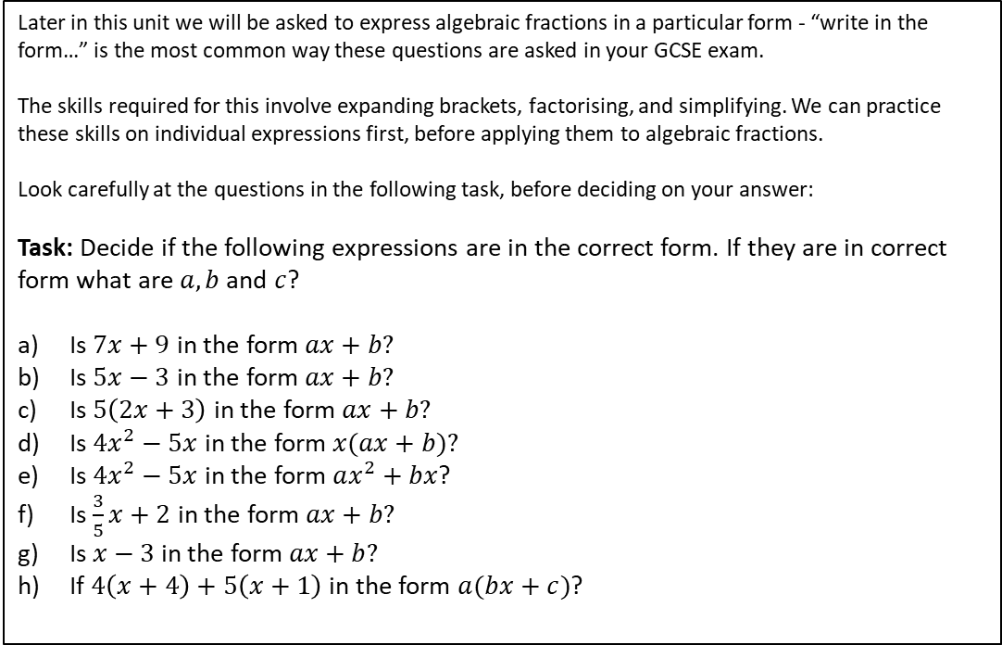
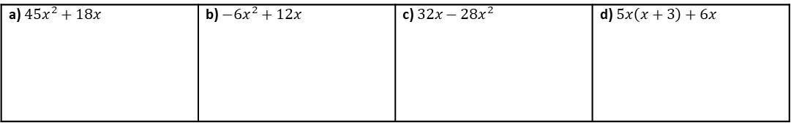
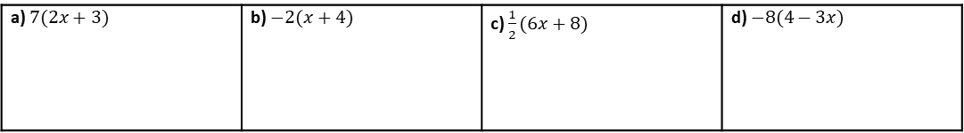
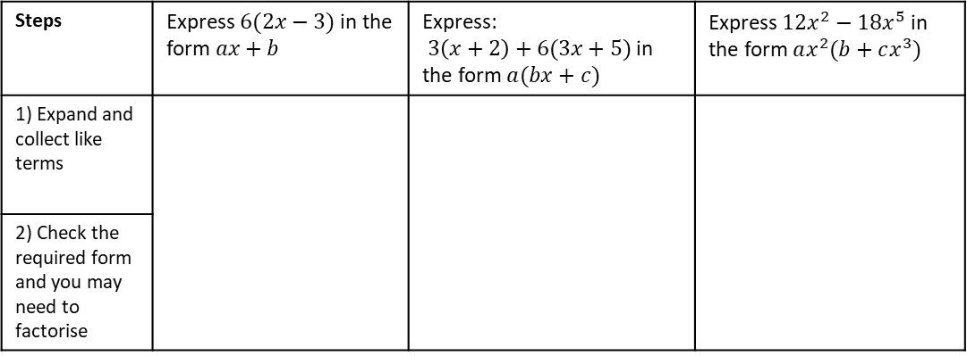
Writing in the correct form
Later in this unit we will be asked to express algebraic fractions in a particular form - “write in the form…” is the most common way these questions are asked in your GCSE exam.
The skills required for this involve expanding brackets, factorising, and simplifying. We can practice these skills on individual expressions first, before applying them to algebraic fractions.
Look carefully at the questions in the following task, before deciding on your answer:
Task: Decide if the following expressions are in the correct form. If they are in correct form what are $a, b$ and $c$?
Is $7x+9$ in the form $ax+b?$
Is $5x−3$ in the form $ax+b?$
Is $5\left(2x+3\right)$ in the form $ax+b?$
Is $4x^{2}−5x$ in the form $x(ax+b)?$
Is $4x^{2}−5x$ in the form $ax^{2}+bx$?
Is $\frac{3}{5}x+2$ in the form $ax+b?$
Is $x−3$ in the form $ax+b?$
If $4\left(x+4\right)+5\left(x+1\right)$ in the form $a(bx+c)$?
Example 1 - I do…
Example 2 - We do…
Example 3 - You do…
Steps | Express $6(2x−3)$ in the form $ax+b$ | Express: $3\left(x+2\right)+6(3x+5)$ in the form $a(bx+c)$ | Express $12x^{2}−18x^{5}$ in the form $ax^{2}(b+cx^{3})$
1) Expand and collect like terms
2) Check the required form and you may need to factorise
INDEPENDENT PRACTICE
Question 1: Express in the form $ax+b$
a) $7(2x+3)$ | b) $−2(x+4)$ | c) $\frac{1}{2}(6x+8)$ | d) $−8(4−3x)$
Question 2: Express in the form $ax(bx+c)$
a) $45x^{2}+18x$ | b) $−6x^{2}+12x$ | c) $32x−28x^{2}$ | d) $5x\left(x+3\right)+6x$

Slide 3
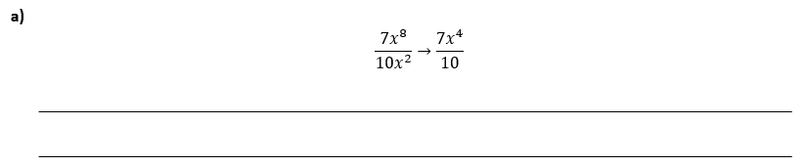


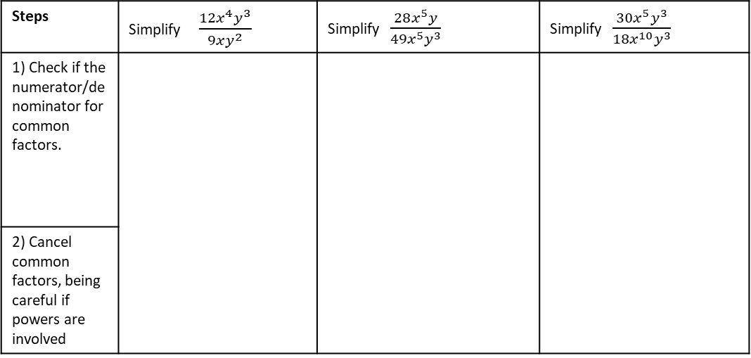








Simplifying basic algebraic fractions
The rules for simplifying algebraic fractions are like those for simplifying a normal fraction: divide (or occasionally multiply) the numerator and denominator by the same amount.
We begin below by simplifying fractions with only single terms in numerator and denominator:
Example 1 - I do…
Example 2 - We do…
Example 3 - You do…
Steps | Simplify $\frac{12x^{4}y^{3}}{9xy^{2}}$ | Simplify $\frac{28x^{5}y}{49x^{5}y^{3}}$ | Simplify $\frac{30x^{5}y^{3}}{18x^{10}y^{3}}$
1) Check if the numerator/denominator for common factors.
2) Cancel common factors, being careful if powers are involved
INDEPENDENT PRACTICE
1. Simplify these algebraic fractions:
a) $\frac{3}{12}$
b) $\frac{3x}{12}$
c) $\frac{3}{12x}$
d) $\frac{12x}{6}$
e) $\frac{12x}{6x}$
f) $\frac{12x^{2}}{3}$
g) $\frac{12x^{2}}{3x^{4}}$
h) $\frac{12a^{3}x^{2}}{3x^{2}}$
i) $\frac{12x}{3x^{2}}$
j) $\frac{10x^{7}y}{12x}$
2. Explain the mistake in the following simplification:

Slide 4
















Simplifying simple algebraic fractions using factorisation
Simplifying Algebraic Fractions will often use your knowledge of factorising – either into singe brackets or double brackets.
Knowledge Check
Factorise these expressions:
a) $4x+12$
b) $3x−9$
c) $6x−8$
d) $12x+30$
e) $x^{2}+4x+3$
f) $y^{2}+9y+8$
g) $n^{2}+6n+5$
h) $k^{2}+12k+35$
i) $x^{2}−4$
j) $y^{2}−16$
k) $x^{2}−49$
l) $x^{2}−121$
m) $2x^{2}−3x−9$
n) $3x^{2}+8x+4$
o) $4x^{2}−9x+2$
p) $3x^{2}+10x+7$

Slide 5




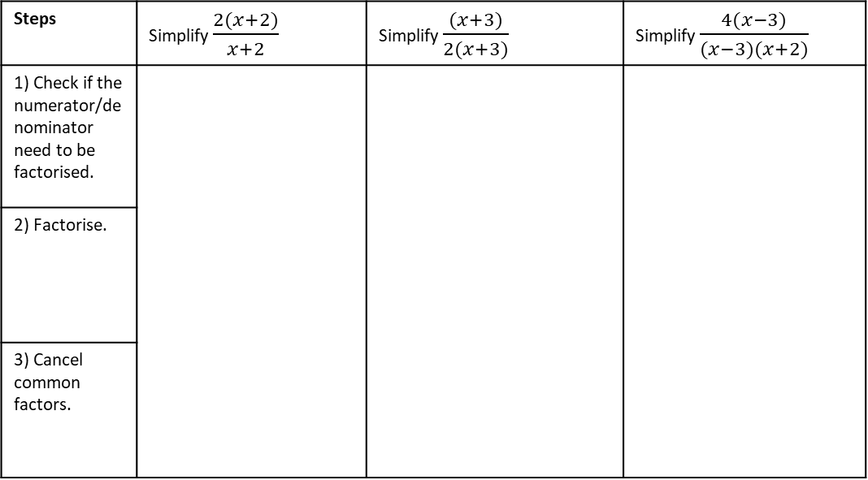






Example 1 - I do…
Example 2 - We do…
Example 3 - You do…
Steps | Simplify $\frac{2(x+2)}{x+2}$ | Simplify $\frac{(x+3)}{2(x+3)}$ | Simplify $\frac{4(x−3)}{(x−3)(x+2)}$
1) Check if the numerator/denominator need to be factorised.
2) Factorise.
3) Cancel common factors.
INDEPENDENT PRACTICE
1. Simplify the algebraic fractions.
a) $\frac{2(x+3)}{3(x+3)}$
b)$\frac{2(x+1)}{(x+3)}$
c)$\frac{\left(x+3\right)}{2(x−3)}$
d)$\frac{x+3}{2(x+3)}$
e) $\frac{\left(x+3\right)(x+6)}{(x+3)}$
f) $\frac{\left(x−1\right)(x+1)}{(x−1)}$
g) $\frac{\left(x−3\right)}{(x−4)(x−3)}$
h) $\frac{\left(x−3\right)(x+2)}{(x+2)(x+9)}$
i) $\frac{\left(x+3\right)(x+6)(x+2)}{(x+3)(x+2)(x−4)}$
j)$\frac{\left(x−3\right)(2x−1)(x+2)}{(x−3)(x+2)(2x−1)}$

Slide 6



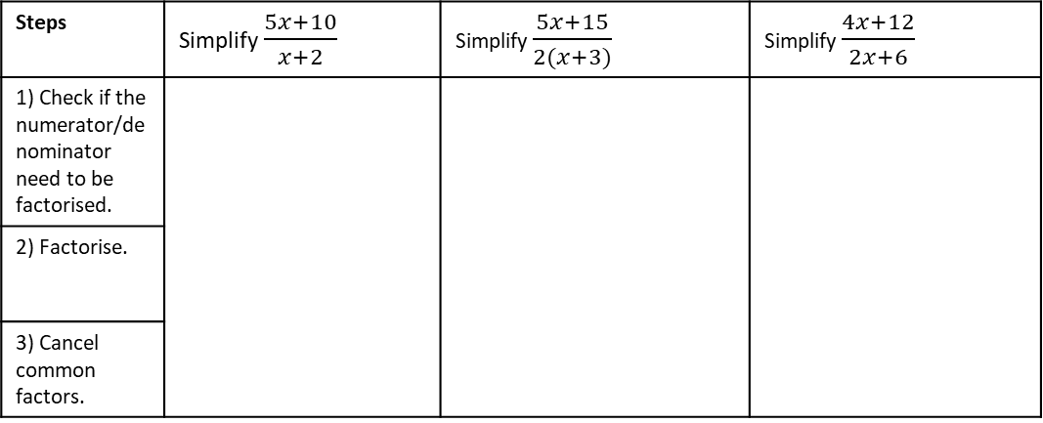

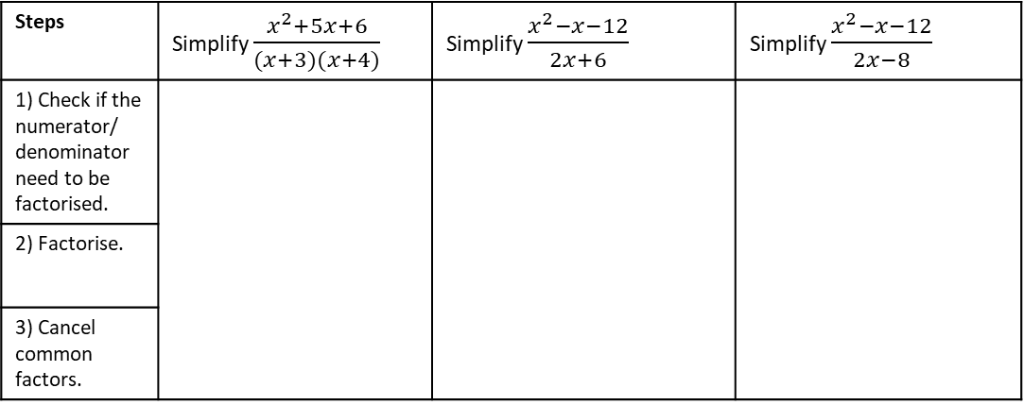




Example 4 - I do…
Example 5 - We do…
Example 6 - You do…
Steps | Simplify $\frac{5x+10}{x+2}$ | Simplify $\frac{5x+15}{2(x+3)}$ | Simplify $\frac{4x+12}{2x+6}$
1) Check if the numerator/denominator need to be factorised.
2) Factorise.
3) Cancel common factors.
INDEPENDENT PRACTICE
2. Simplify the algebraic fractions.
a) $\frac{2x+2}{3(x+1)}$
b)$\frac{2x+2}{3x+3}$
c)$\frac{3x+3}{2(x+1)}$
d)$\frac{x+3}{2(x+3)}$
e) $\frac{4x+12}{3(x+3)}$
f) $\frac{4x+12}{(x+1)(x+3)}$
g) $\frac{x+3}{4x+12}$
h) $\frac{5x+15}{x+3}$
Example 7 - I do…
Example 8 - We do…
Example 9 - You do…
Steps | Simplify $\frac{x^{2}+5x+6}{(x+3)(x+4)}$ | Simplify $\frac{x^{2}−x−12}{2x+6}$ | Simplify $\frac{x^{2}−x−12}{2x−8}$
1) Check if the numerator/ denominator need to be factorised.
2) Factorise.
3) Cancel common factors.

Slide 7










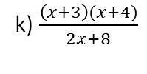

i) $\frac{\left(x+3\right)(x+6)}{2x+6}$
j) $\frac{\left(x+3\right)(x+4)}{2x+6}$
k) $\frac{\left(x+3\right)(x+4)}{2x+8}$
l)$\frac{x^{2}+7x+12}{2x+8}$
m) $\frac{x^{2}+7x+12}{(x+4)(x−9)}$
n) $\frac{x^{2}+7x+12}{x^{2}−5x−36}$
o) $\frac{2x^{2}+14x+24}{x^{2}−5x−36}$
p) $\frac{2x^{2}+14x+24}{3x^{2}−15x−108}$
q) $\frac{{2x}^{2}+14x+24}{3x^{2}+4x−15}$
r) $\frac{14x−24−2x^{2}}{{3x}^{2}+4x−15}$
s) $\frac{14x−24−2x^{2}}{3x^{2}−4x−15}$
t) $\frac{10x^{2}−23x+12}{4x^{2}+4x−15}$

Slide 8





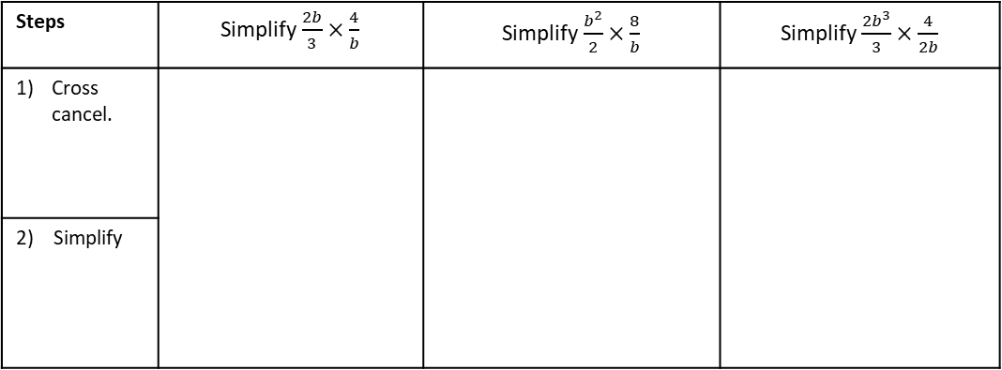



Multiplying and Dividing Algebraic Fractions
Multiplying and diving single term algebraic fractions works similarly to the numerical case:
For multiplication, the new numerator is the product of the numerators, the new denominator is the product of the denominators. Once the numerator and denominator are calculated, simplify if possible.
For division we need to rewrite the calculation so that we are multiplying by the reciprocal of the second fraction.
Knowledge Check: Cross Simplification
a) $\frac{3}{15}×\frac{5}{11}=$
b) $\frac{5}{14}×\frac{21}{15}=$
c) $\frac{13}{80}×\frac{20}{39}=$
Example 13 - I do…
Example 14 - We do…
Example 15 - You do…
Steps | Simplify$\frac{2b}{3}×\frac{4}{b}$ | Simplify$\frac{b^{2}}{2}×\frac{8}{b}$ | Simplify$\frac{2b^{3}}{3}×\frac{4}{2b}$
Cross cancel.
2) Simplify
INDEPENDENT PRACTICE
3. Simplify the algebraic fractions.
a) $\frac{b}{4}×\frac{4}{b}$
b) $\frac{b^{2}}{4}×\frac{4}{b}$
c) $\frac{b^{3}}{4}×\frac{4}{2b^{2}}$
d) $\frac{b^{3}}{4}×\frac{8}{2b^{2}}$
e) $\frac{8}{b^{3}}×\frac{2b^{2}}{4}$

Slide 9

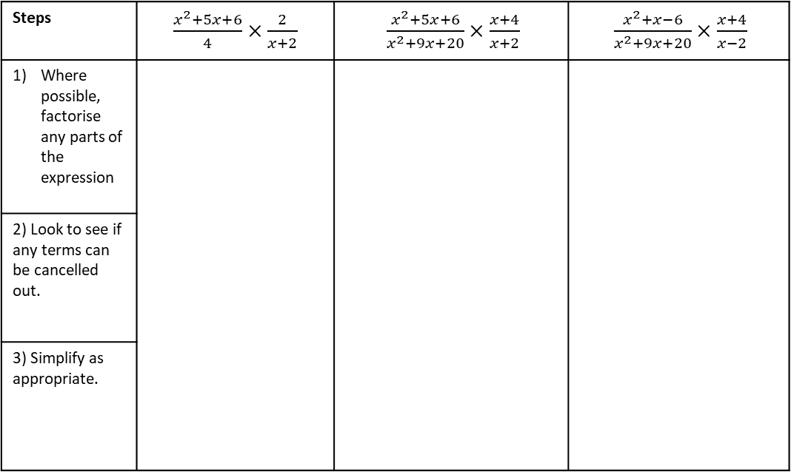
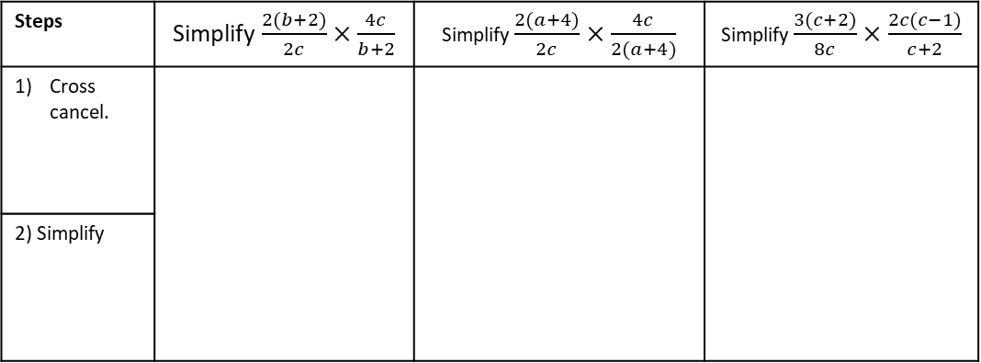



Example 16 - I do…
Example 17 - We do…
Example 18 - You do…
Steps | Simplify$\frac{2(b+2)}{2c}×\frac{4c}{b+2}$ | Simplify $\frac{2(a+4)}{2c}×\frac{4c}{2(a+4)}$ | Simplify $\frac{3(c+2)}{8c}×\frac{2c(c−1)}{c+2}$
Cross cancel.
2) Simplify
INDEPENDENT PRACTICE
4. Simplify the algebraic fractions.
a) $\frac{2(x+2)}{2c}×\frac{4c}{x+2}$
b) $\frac{2(x−2)}{2c}×\frac{4c}{x−2}$
c) $\frac{2(x+2)}{2c^{3}}×\frac{4c^{2}}{x+2}$
d) $\frac{2x+4}{2c}×\frac{4c^{3}}{x+2}$
Example 16 - I do…
Example 17 - We do…
Example 18 - You do…
Steps | $\frac{x^{2}+5x+6}{4}×\frac{2}{x+2}$ | $\frac{x^{2}+5x+6}{x^{2}+9x+20}×\frac{x+4}{x+2}$ | $\frac{x^{2}+x−6}{x^{2}+9x+20}×\frac{x+4}{x−2}$
Where possible, factorise any parts of the expression
2) Look to see if any terms can be cancelled out.
3) Simplify as appropriate.

Slide 10

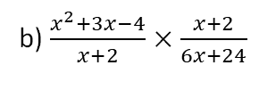
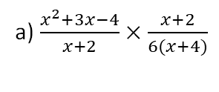
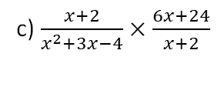
INDEPENDENT PRACTICE
5. Simplify the algebraic fractions.
a) $\frac{x^{2}+3x−4}{x+2}×\frac{x+2}{6(x+4)}$
b) $\frac{x^{2}+3x−4}{x+2}×\frac{x+2}{6x+24}$
c) $\frac{x+2}{x^{2}+3x−4}×\frac{6x+24}{x+2}$
d) $\frac{{\left(x+1\right)}^{2}}{x^{2}+3x−4}×\frac{x−1}{x+1}$

Slide 11

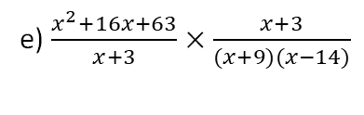
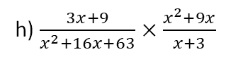

e) $\frac{x^{2}+16x+63}{x+3}×\frac{x+3}{(x+9)(x−14)}$
f) $\frac{x^{2}+16x+63}{x+3}×\frac{x+3}{x^{2}+9x}$
g)$\frac{x^{2}+16x+63}{3x+9}×\frac{x+3}{x^{2}+9x}$
h) $\frac{3x+9}{x^{2}+16x+63}×\frac{x^{2}+9x}{x+3}$

Slide 12
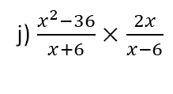
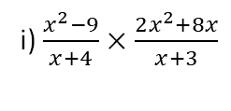
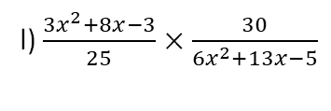
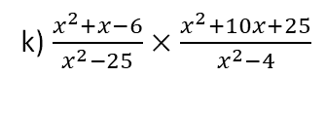
i) $\frac{x^{2}−9}{x+4}×\frac{2x^{2}+8x}{x+3}$
j) $\frac{x^{2}−36}{x+6}×\frac{2x}{x−6}$
k) $\frac{x^{2}+x−6}{x^{2}−25}×\frac{x^{2}+10x+25}{x^{2}−4}$
l) $\frac{3x^{2}+8x−3}{25}×\frac{30}{6x^{2}+13x−5}$

Slide 13
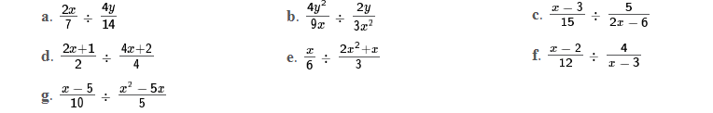
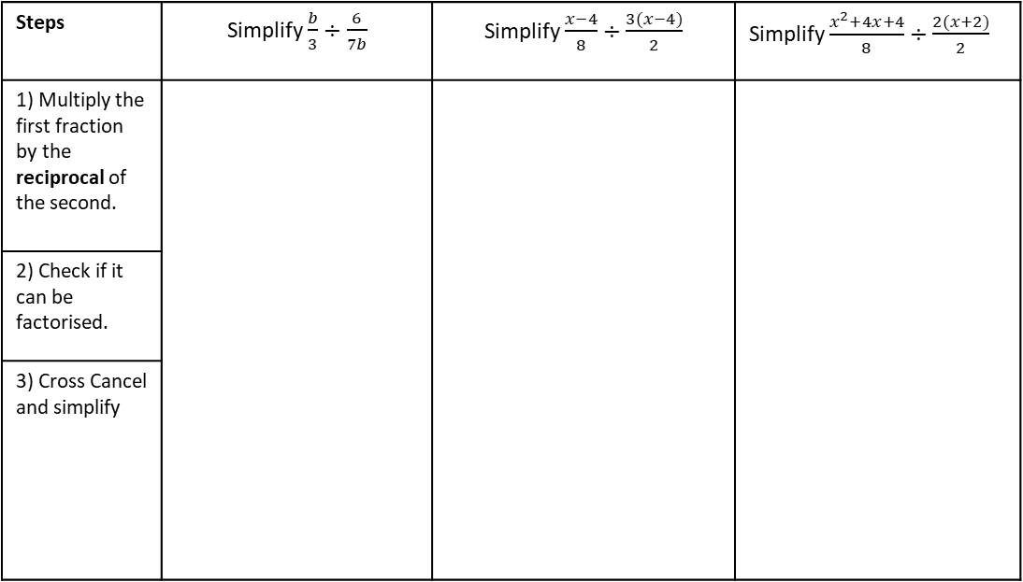

Example 19 - I do…
Example 20 - We do…
Example 21 - You do…
Steps | Simplify $\frac{b}{3}÷\frac{6}{7b}$ | Simplify $\frac{x−4}{8}÷\frac{3(x−4)}{2}$ | Simplify $\frac{x^{2}+4x+4}{8}÷\frac{2(x+2)}{2}$
1) Multiply the first fraction by the reciprocal of the second.
2) Check if it can be factorised.
3) Cross Cancel and simplify
INDEPENDENT PRACTICE
6. Simplify the algebraic fractions.
h. $\frac{3x+9}{2}÷\frac{x+3}{4}$

Slide 14
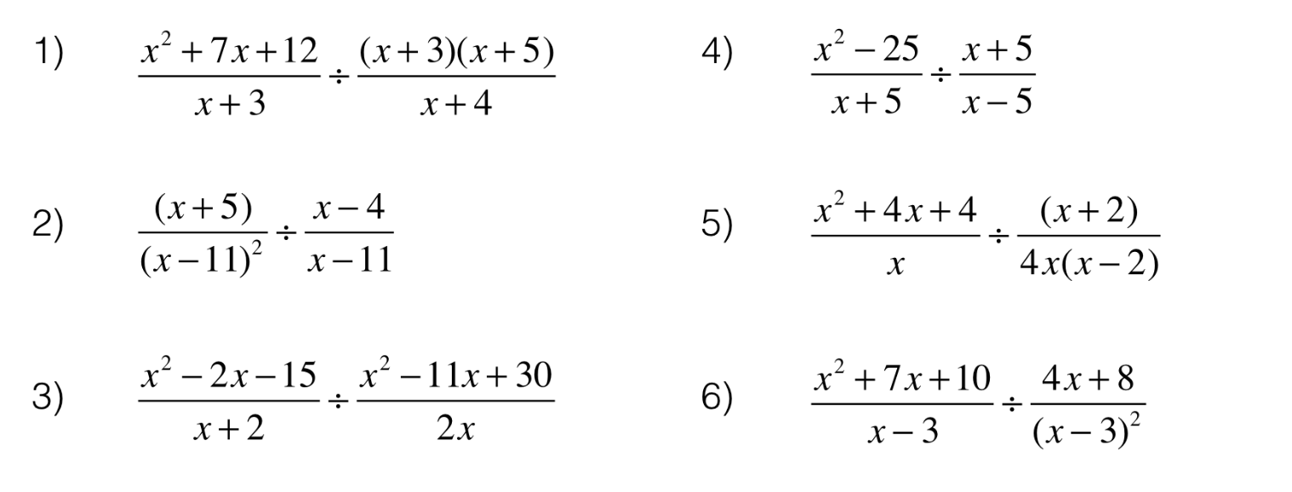







INDEPENDENT PRACTICE
i. $\frac{4}{x−2}÷\frac{3}{x^{2}−2x}$
j. $\frac{11}{4x^{2}+2x}÷\frac{3}{2x+1}$
k. $\frac{x+3}{x+1}÷\frac{x}{{\left(x+1\right)}^{2}}$
l. $\frac{x^{2}}{7}÷\frac{6x^{3}+8x^{2}}{x^{2}−7x}$
m. $\frac{x^{2}+7x+10}{2}÷\frac{x^{2}+4x−5}{4}$
n. $\frac{14}{x^{2}−5x+6}÷\frac{7}{x^{2}+3x−10}$
o. $\frac{x+4}{x+5}÷\frac{3x+12}{x^{2}−25}$
p.
q.

Slide 15
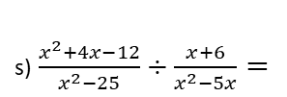
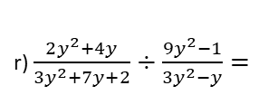



r) $\frac{2y^{2}+4y}{3y^{2}+7y+2}÷\frac{9y^{2}−1}{3y^{2}−y}=$
s)$\frac{x^{2}+4x−12}{x^{2}−25}÷\frac{x+6}{x^{2}−5x}=$
t) $\frac{3x^{2}−5x−2}{x^{2}−4x}÷\frac{3x+1}{x^{2}−8x+16}$
u) $\frac{3x^{2}+8x−3}{25}÷\frac{6x^{2}+13x−5}{30}$
v) $\frac{x^{3}−x}{x^{4}−1}÷\frac{x+1}{x^{3}+x}$

Slide 16
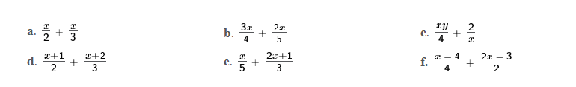













Adding and Subtracting Algebraic Fractions
When the algebraic fractions we want to add or subtract have different denominators, it is necessary to find a common denominator. As with numerical fractions we do this by finding the lowest common multiple of the denominators.
Knowledge Check
Evaluate and simplify the following:
a) $\frac{1}{4}+\frac{1}{3}$
b) $\frac{1}{6}+\frac{2}{5}$
c) $\frac{3}{10}−\frac{1}{5}$
d) $\frac{3}{7}+\frac{2}{5}$
e) $\frac{5}{6}−\frac{5}{7}$
Example 22 - I do…
Example 23 - We do…
Example 24 - You do…
Simplify $\frac{x}{7}+\frac{3x}{8}$
Steps
1) Find the Lowest common denominator
2) Multiply the numerators.
3) Write in simplest form.
Simplify $\frac{x}{5}+\frac{3x}{8}$
Simplify $\frac{2x}{5}+\frac{3x}{7}$
INDEPENDENT PRACTICE
a) $\frac{3x}{2}+\frac{4x}{5}$
b) $\frac{x}{2}+\frac{4x}{5}$
c) $\frac{x}{2}+\frac{x}{5}$
d) $\frac{x}{2}−\frac{x}{5}$
e) $\frac{5x}{5}−\frac{x}{2}$

Slide 17








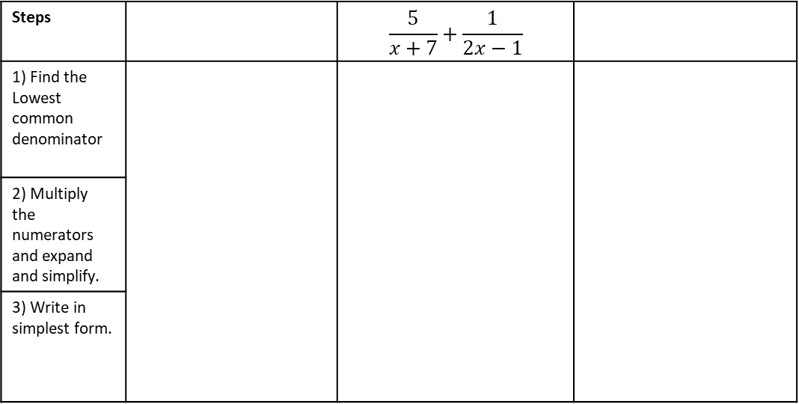


Example 25 - I do…
Example 26 - We do…
Example 27 - You do…
Simplify $\frac{x+1}{2}+\frac{x+3}{3}$
Simplify $\frac{x+5}{3}+\frac{x−2}{4}$
Steps |  | $$\frac{5}{x+7}+\frac{1}{2x−1}$$
1) Find the Lowest common denominator
2) Multiply the numerators and expand and simplify.
3) Write in simplest form.
INDEPENDENT PRACTICE
7. Simplify the algebraic fractions.
a) $\frac{x+2}{4}+\frac{x+2}{5}$
c) $\frac{x−3}{4}+\frac{x+2}{3}$
d) $\frac{3}{x−1}+\frac{4}{3x+2}$
e) $\frac{x−1}{5}+\frac{x+2}{3}$
f) $\frac{x−4}{4}+\frac{2x−3}{2}$
g) $\frac{3x+2}{4}−\frac{x−2}{5}$
h) $\frac{4x+2}{2}−\frac{x+3}{3}$
i) $\frac{2x+1}{4}−\frac{2x−1}{3}$

Slide 18











j) $\frac{2x+1}{2}−\frac{2x+1}{4}$
k) $\frac{3x−2}{2}−\frac{4x−3}{4}$
l) $\frac{5x−4}{4}−\frac{2x−3}{2}$
m) $\frac{7x+5}{5}−\frac{2x+1}{3}$
Example 28 - I do…
Example 29 - We do…
Example 30 - You do…
Simplify $\frac{7}{3x}+\frac{5}{x^{2}}$
Steps
1) Find the Lowest common denominator
2) Multiply the numerators and expand and simplify.
3) Write in simplest form.
Simplify $\frac{5}{x}+\frac{8}{3x}$
Simplify $\frac{7}{2x}+\frac{2}{x^{2}}$
INDEPENDENT PRACTICE
8. Simplify the algebraic fractions.
a) $\frac{5}{x}+\frac{2}{x}$
b) $\frac{5}{x^{2}}+\frac{2}{x}$
c) $\frac{5}{2x^{2}}−\frac{2}{x}$
d) $\frac{6}{2x^{2}}−\frac{2}{x}$

Slide 19




DEPTH: ADDING AND SUBTRACTING INVOLVING QUADRATICS/DOUBLE BRACKETS
When we are adding and subtracting algebraic fractions, it is sometimes necessary to either expand double brackets or factorise quadratics.
Steps
1) Find the Lowest common denominator
2) Multiply the numerators and expand and collect terms..
3) Check if any final simplification is possible .
Example 31 - I do…
Example 32 - You do…
Express the following as a single simplified fraction.
$$\frac{x−3}{x+2}+\frac{x+5}{x−2}$$
Express the following as a single simplified fraction.
$$\frac{x+7}{x−3}+\frac{x−2}{x+4}$$
Steps
1) Find the Lowest common denominator
2) Multiply the numerators and expand and collect terms..
3) Check if any final simplification is possible .
Example 33 - I do…
Example 34 - You do…
Express the following a single simplified fraction.
$$\frac{10x+9}{x^{2}+6x+5}−\frac{3}{x+5}$$
Express the following a single simplified fraction.
$$\frac{4x+1}{x^{2}−2x−15}−\frac{3}{x+3}$$

Slide 20
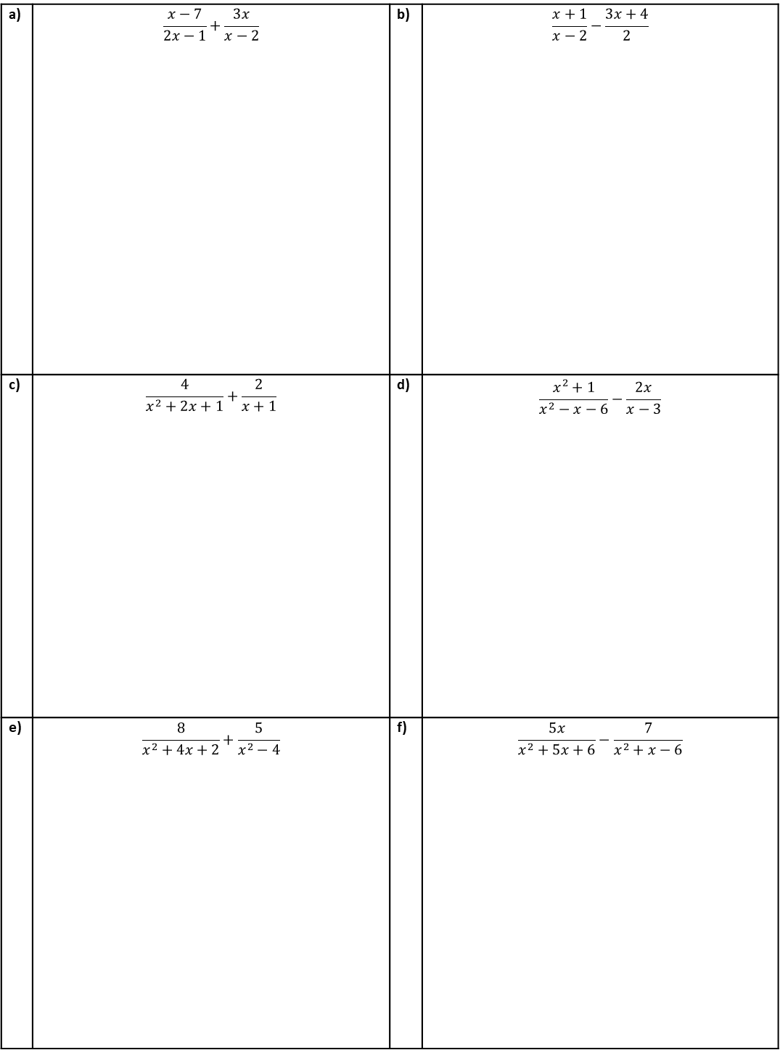
INDEPENDENT PRACTICE
Question 9. Write as a single fraction, simplify where possible.
a) | $$\frac{x−7}{2x−1}+\frac{3x}{x−2}$$ | b) | $$\frac{x+1}{x−2}−\frac{3x+4}{2}$$
c) | $$\frac{4}{x^{2}+2x+1}+\frac{2}{x+1}$$ | d) | $$\frac{x^{2}+1}{x^{2}−x−6}−\frac{2x}{x−3}$$
e) | $$\frac{8}{x^{2}+4x+2}+\frac{5}{x^{2}−4}$$ | f) | $$\frac{5x}{x^{2}+5x+6}−\frac{7}{x^{2}+x−6}$$

Slide 21
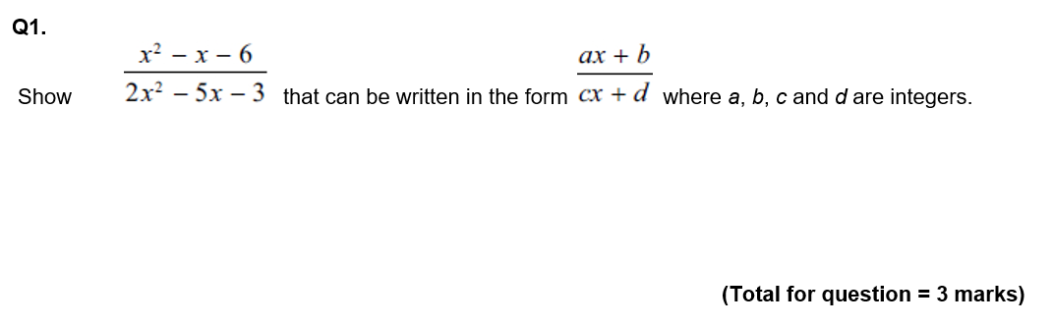
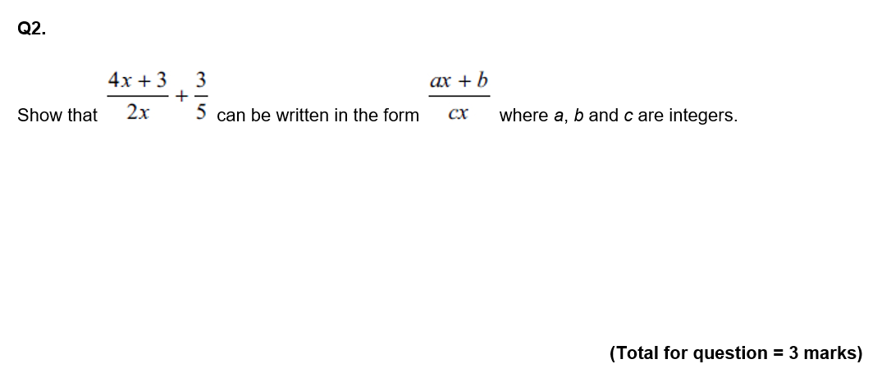
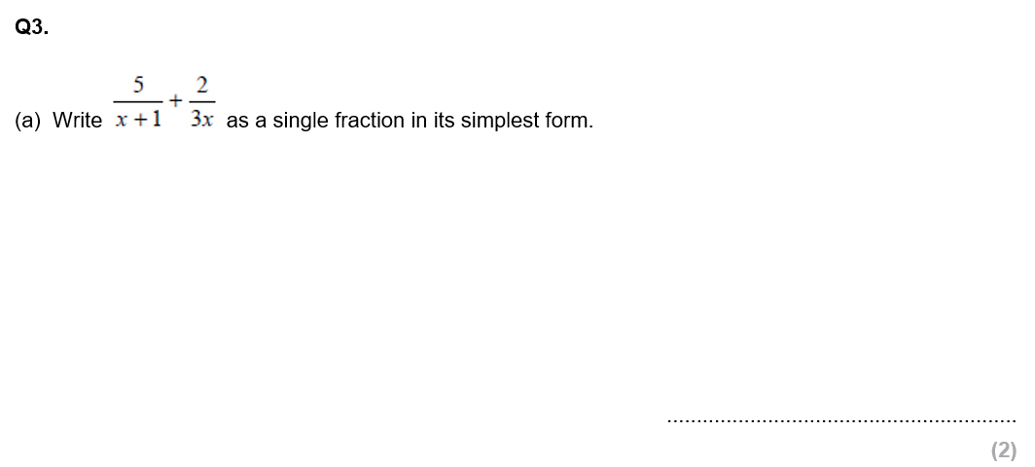
GCSE QUESTIONS

Slide 22
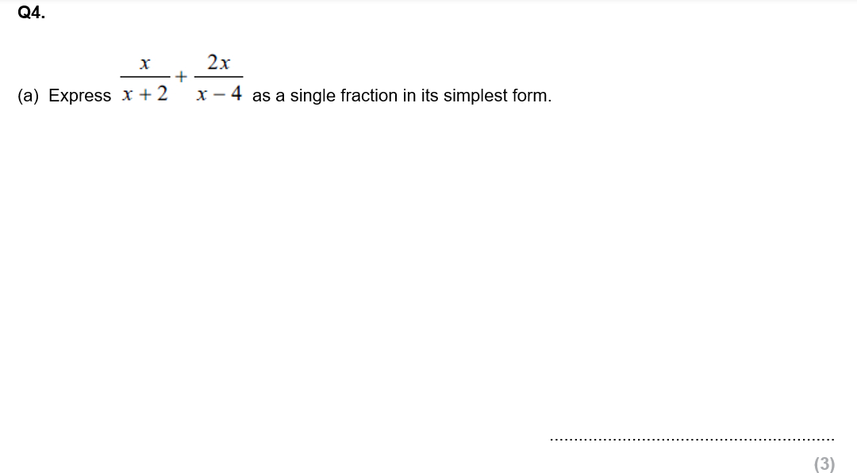
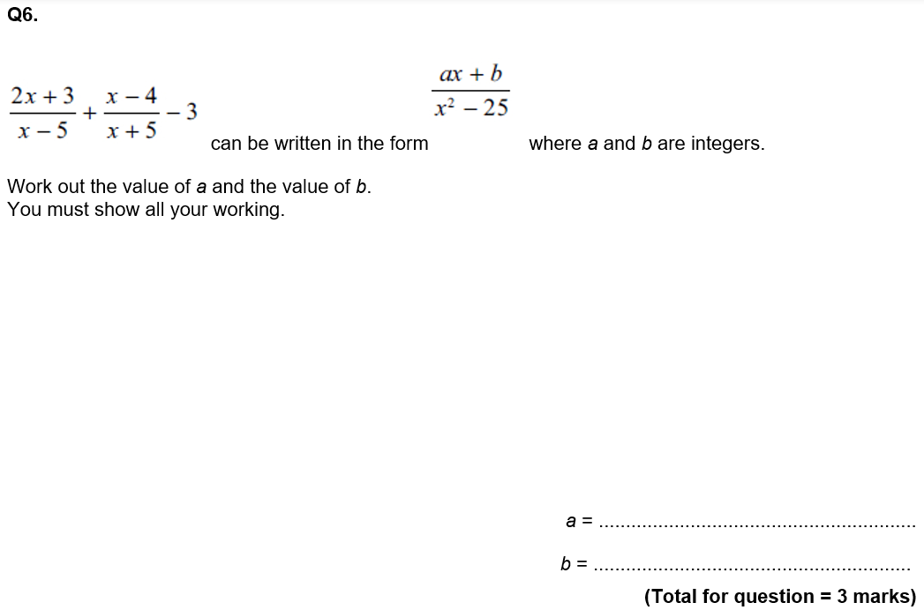

Slide 23
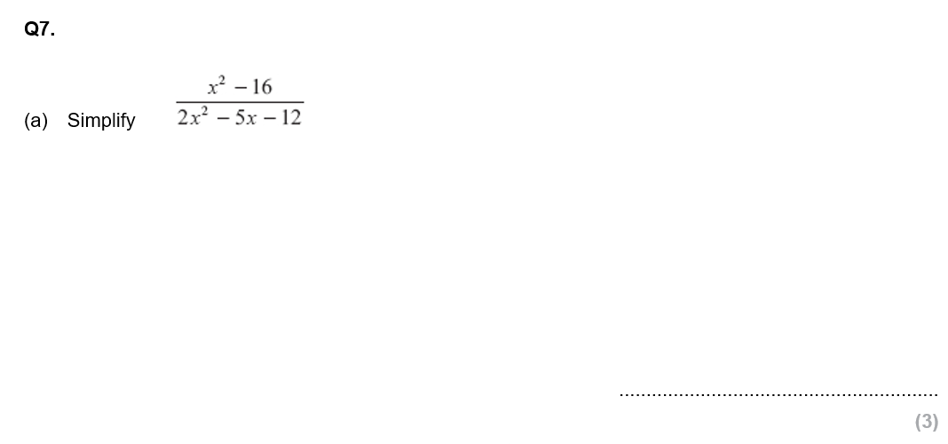
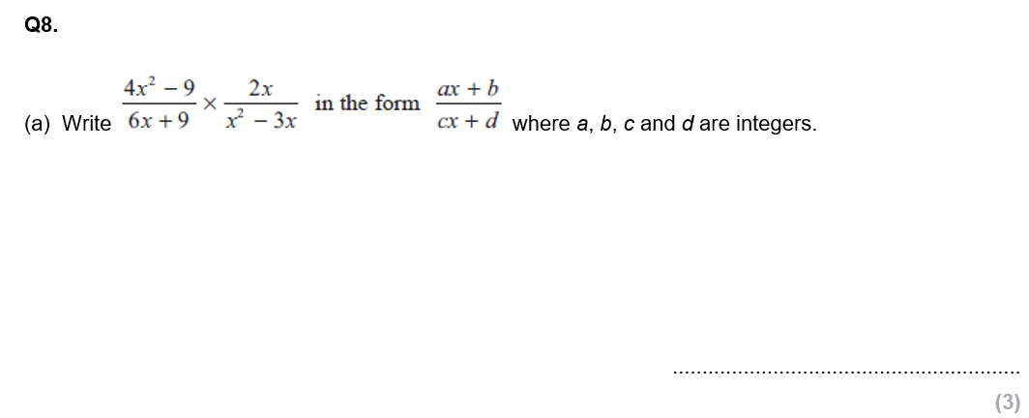
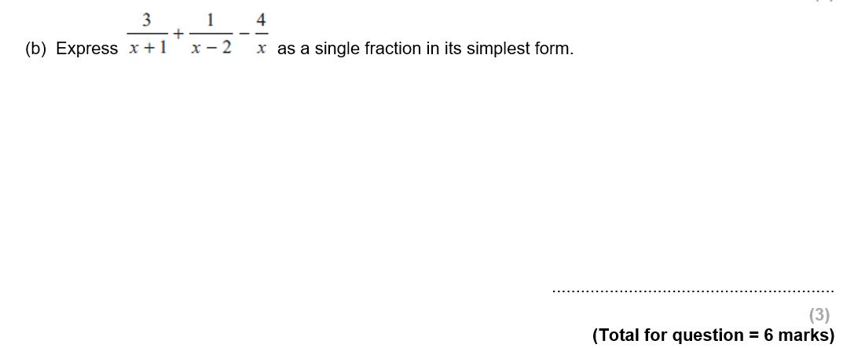

Slide 24
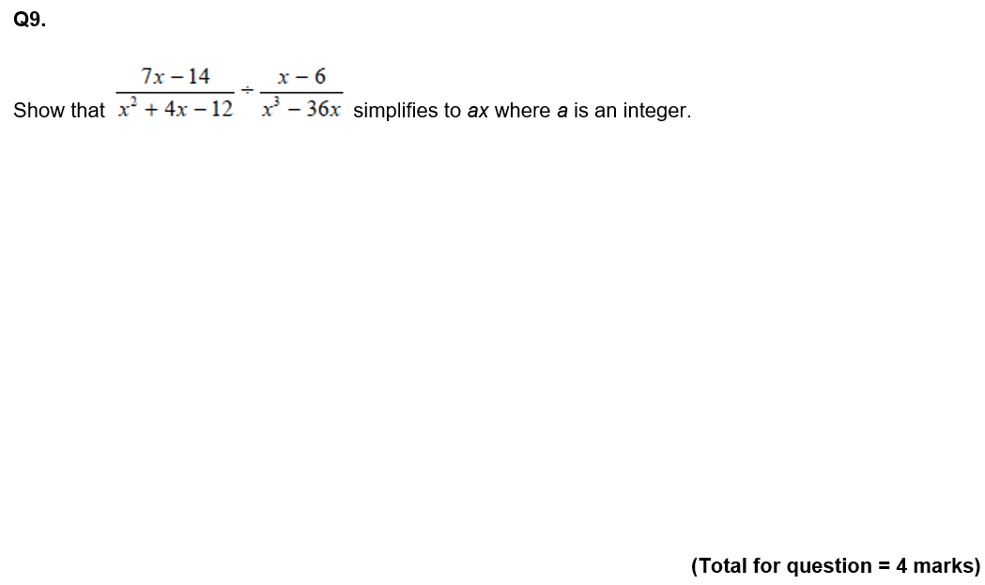
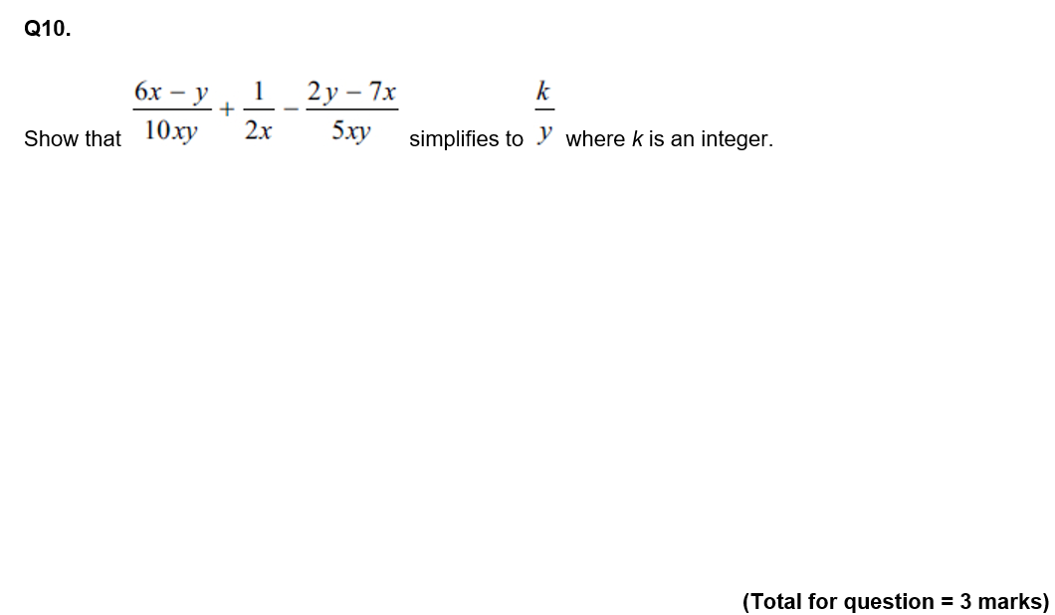

Slide 25








Subtopic 4b – Algebraic Fractions: Solving
We can solve equations involving algebraic fractions in one of two ways:
Simplify the equation so that each side is either a single algebraic fraction or an expression. Multiply through by the denominators of any algebraic fractions – leaving an equation with no algebraic fractions to be solved.
Calculate the lowest common multiple of the denominators of the algebraic fractions. Multiply through by this expression to again reach an equation free of algebraic fractions.
Before we do this, we need to recap the solving of equations involving fractions that you have seen before. Attempt the questions below independently, showing clearly what you do for the steps at each stage.
Knowledge Check
a) $\frac{x+5}{7}=5$
b)$\frac{3x−2}{5}=4$
c) $\frac{x−4}{7}=3$
d) $3=\frac{2y+1}{5}$
e) $\frac{5a+3}{4}=7$
f) Solve $\frac{3x}{5}=\frac{x+1}{10}$
g) Solve $\frac{x+4}{2}=\frac{x+10}{3}$
h) Solve $\frac{x−2}{3}=\frac{x+4}{5}$

Slide 26




Example 31 - I do…
Example 32 - We do…
Steps
1) Multiply through to make the denominators the same. (or: clear the fraction by multiplying both sides appropriately)
2) Expand and simplify the numerators.
3) Solve the equation.
Solve $\frac{5y+8}{6}−\frac{3y+2}{4}=1$
Solve $\frac{6x−1}{4}−\frac{5−2x}{2}=7$
Example 33 - You do…
Example 34 - You do…
Steps
1) Multiply through to make the denominators the same. (or: clear the fraction by multiplying both sides appropriately)
2) Expand and simplify the numerators.
3) Solve the equation.
Solve $\frac{x−1}{2}+\frac{2x+3}{4}=1$
Solve $\frac{2x+1}{3}+\frac{x−5}{2}=4$

Slide 27
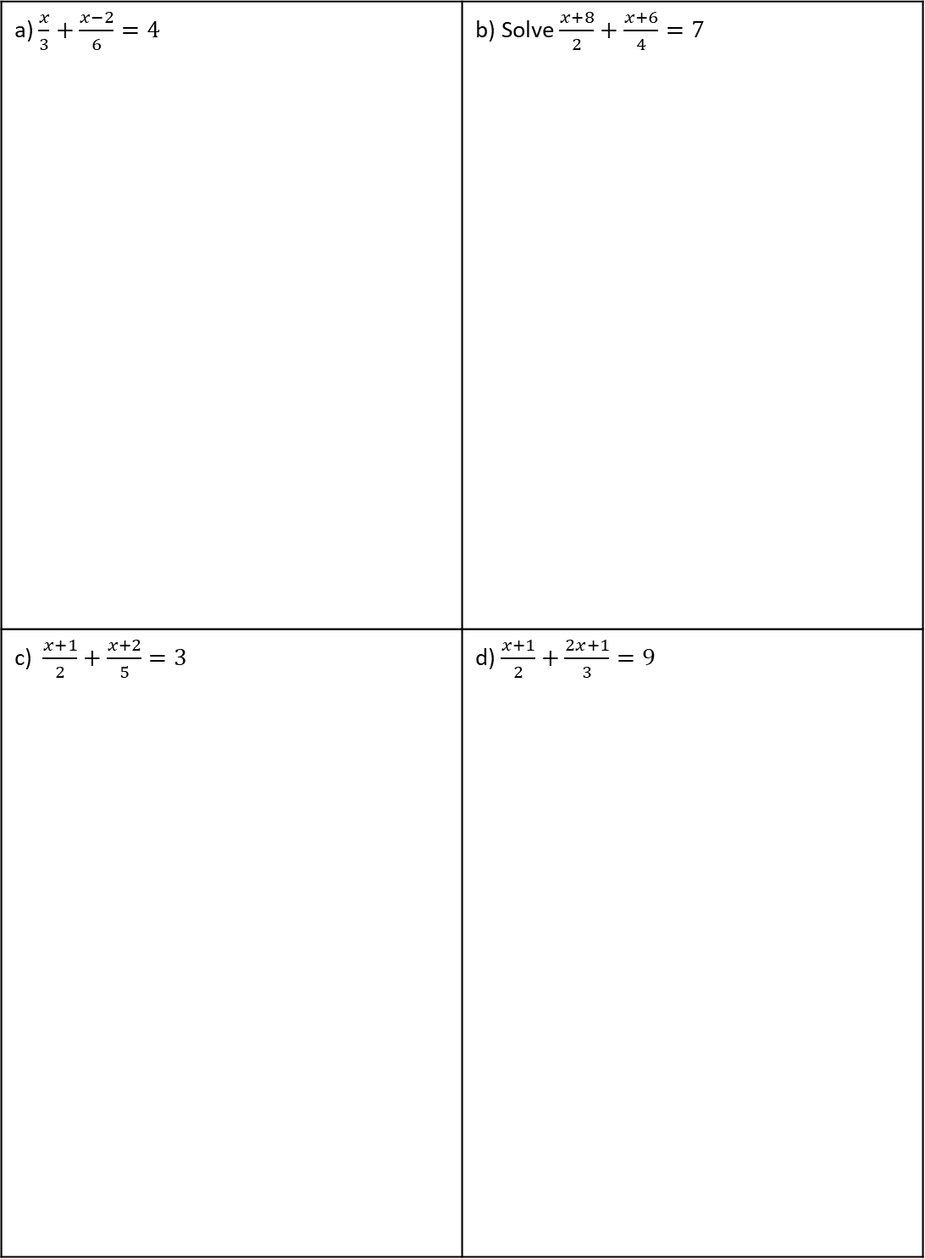
INDEPENDENT PRACTICE
1. Solve the algebraic fractions.
a) $\frac{x}{3}+\frac{x−2}{6}=4$ | b) Solve $\frac{x+8}{2}+\frac{x+6}{4}=7$
c) $\frac{x+1}{2}+\frac{x+2}{5}=3$ | d) $\frac{x+1}{2}+\frac{2x+1}{3}=9$
27

Slide 28
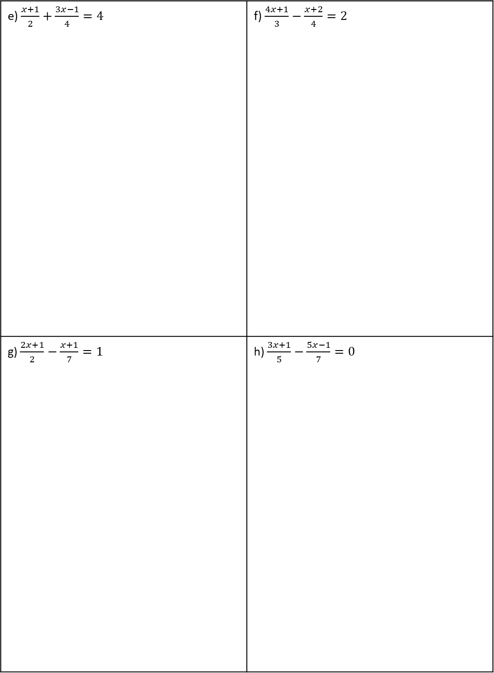
e) $\frac{x+1}{2}+\frac{3x−1}{4}=4$ | f) $\frac{4x+1}{3}−\frac{x+2}{4}=2$
g) $\frac{2x+1}{2}−\frac{x+1}{7}=1$ | h) $\frac{3x+1}{5}−\frac{5x−1}{7}=0$

Slide 29






Example 35 - I do…
Example 36 - We do…
Solve $\frac{4}{x+6}+\frac{5}{x+8}=1$
Solve $\frac{3}{x−6}+\frac{4}{x−9}=1$
Steps
1) Multiply through the make the denominators the same.
2) Expand and simplify the numerators.
3) Multiply through by the denominator.
4) Expand and simplify the RHS.
5) Rearrange into form $ax^{2}+bx+c=0$
6) Solve the quadratic equation.
Example 37 - You do…
Example 38 - You do…
Steps
1) Multiply through the make the denominators the same.
2) Expand and simplify the numerators.
3) Multiply through by the denominator.
4) Expand and simplify the RHS.
5) Rearrange into form $ax^{2}+bx+c=0$
6) Solve the quadratic equation.
Solve $\frac{2}{x+6}+\frac{4}{x+8}=2$
Solve $\frac{4}{x−5}+\frac{2}{x−8}=3$

Slide 30





INDEPENDENT PRACTICE
10. Solve the algebraic fractions.
a)
b)
c)
$x=$ or $x=$
$x=$ or $x=$
$x=$ or $x=$
d)
e)
f)
$x=$ or $x=$
$x=$ or $x=$
$x=$ or $x=$

Slide 31

INDEPENDENT PRACTICE
10. Solve the algebraic fractions.
g)
h)
i)
$x=$ or $x=$
$x=$ or $x=$
$x=$ or $x=$
j)
k)
l)
$x=$ or $x=$
$x=$ or $x=$
$x=$ or $x=$

Slide 32



Show that $\frac{4}{x}+\frac{2}{x−1}$ simplifies to $\frac{6x−4}{x\left(x−1\right)}$
b) Hence or otherwise, solve $\frac{4}{x}+\frac{2}{x−1}=3$, giving your solutions correct to 3sf.
$x=$ or $x=$
2)
$x=$ or $x=$
3)

Slide 33


GCSE QUESTIONS

Slide 34



